Slide 1
Downsampling Time Series Data for Visualizations (and other uses)
The Largest Triangle Three Bucket Algorithm
Delaina Moore, Data Scientist
Notes:
Notes go here.

Slide 2
The Introduction
The Largest Triangle Three Bucket (LTOB) Algorithm
Down sample timeseries data for visualizations
Limit the number of data points, but keep the general shape
Can also be used beyond visualizations and for other preprocessing and down sampling purposes
Downsampling Time Series for Visual Representation by Sveinn Steinarsson
Many other algorithms are explored in this thesis, but the LTOB was examined to
be the most precise and efficient for this use case.

Slide 3
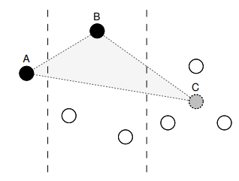
The Math
Separate data into buckets
# buckets == # sampled points
Choosing one point per bucket from left to right
A is either the first point or the previous chosen point (previous B)
C is a temporary point (average of the points in bucket 3)
Calculate the area of each triangle
A-B1-C
A-B2-C
A-B3-C
Keep the point in bucket 2 that creates the triangle with largest area
B1
A
C
B2
B3
1
2
3
Notes:
The algorithm breaks the data into equal buckets, the first and last bucket only containing either the first and last point. Moving from left to right, 3 buckets are isolated and triangles are formed using these buckets. The first point comes from the first bucket, as it will only contain one point (either the first point or a single point chosen in the previous run). The third point of the triangle is the midpoint of all the data in the third bucket. The second point varies from point to point in the middle bucket. The area of each triangle formed from each of these points is calculated. The point that creates the 'largest triangle' is the point that is chosen for the downsampled data. The buckets are then shifted over (so bucket 2 is now bucket 1) and the process is repeated.

Slide 4
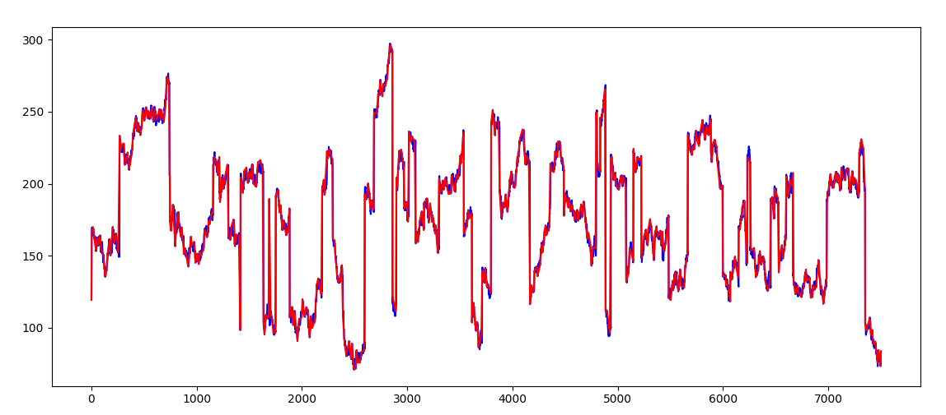
The Demo
Data
Sampled

Slide 5
References
Steinarsson, Sveinn. “Downsampling Time Series for Visual Representation.” School of Engineering and Natural Sciences University of Iceland, Háskólaprent, Fálkagata , 2013.
Sveinn Steinarsson’s GitHub Repo: sveinn-steinarsson/flot-downsample: Downsample plugin for Flot charts. (github.com)
-Adaption of algorithm in several languages
Notes:
The LTOB will need to be ran within the script or saved as a .py file and imported in the script. The function takes in a dataframe that must have a 'time' and 'data' column. The columns MUST be in that order, but the name of the columns do not matter. The function also requires a threshold, i.e. the number of buckets/data points the user wishes the data to be reduced to. The function returns a dataframe containing the downsampled data and the original index as a column.

